Slide 1
Project Cost Management
PMI Knowledge Areas

Slide 2
Project Cost Management Processes
Process Group | Cost Management Process | Major Output
Planning | CP1: Planning Cost Mgmt | Cost Management Plan
 | CP2: Estimating Costs | Activity Cost Estimates
 | CP3: Determining the Budget | Cost Performance Baseline
Monitoring and Controlling | MC1: Controlling Costs | Work Perf. Measurements Budget Forecasts

Slide 3
Types of Costs and Benefits
Tangible costs or benefits
Intangible costs or benefits
Direct costs
Indirect costs
Sunk cost
Basic Principles of Cost Management
Learning curve theory
Reserves
Contingency reserves
Management reserves

Slide 4
CP1: Planning Cost Management
The project team uses expert judgment, analytical techniques, and meetings to develop the cost management plan
A cost management plan includes:
Level of accuracy and units of measure
Organizational procedure links
Control thresholds
Rules of performance measurement
Reporting formats
Process descriptions

Slide 5
CP2: Estimating Costs
Project managers must take cost estimates seriously if they want to complete projects within budget constraints
It’s important to know the types of cost estimates, how to prepare cost estimates, and typical problems associated with IT cost estimates
Input
1) HR Plan 2) Project Schedule 3) Scope Baseline 4) Risk Register
Tools/Techniques
1) EstimatingTechniques 2) Cost of Quality 3) Reserve Analysis 4) PM Estimate Software 5) Expert Judgment
Output
1) Activity cost estimates 2) Estimate Bases 3) Update docs

Slide 6
My Health Intranet Sites
What are the primary costs for the intranet site project?
What is the best way to create estimates for the project?

Slide 7
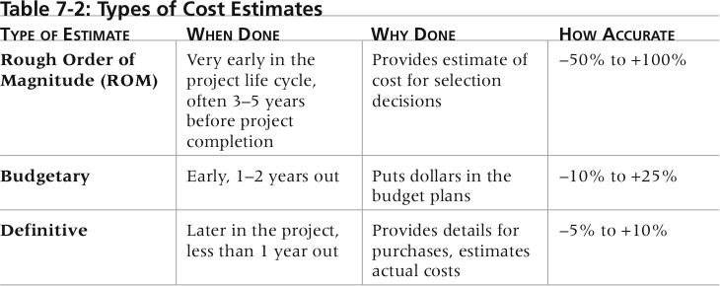
Categories of Cost Estimates
The number and type of cost estimates vary by application area.

Slide 8
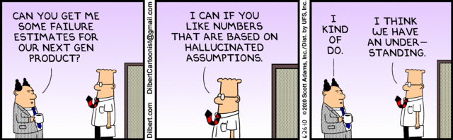
Cost Estimation Techniques
Basic tools and techniques for cost estimates:
Top-down estimates
Analogous
Parametric modeling

Slide 9
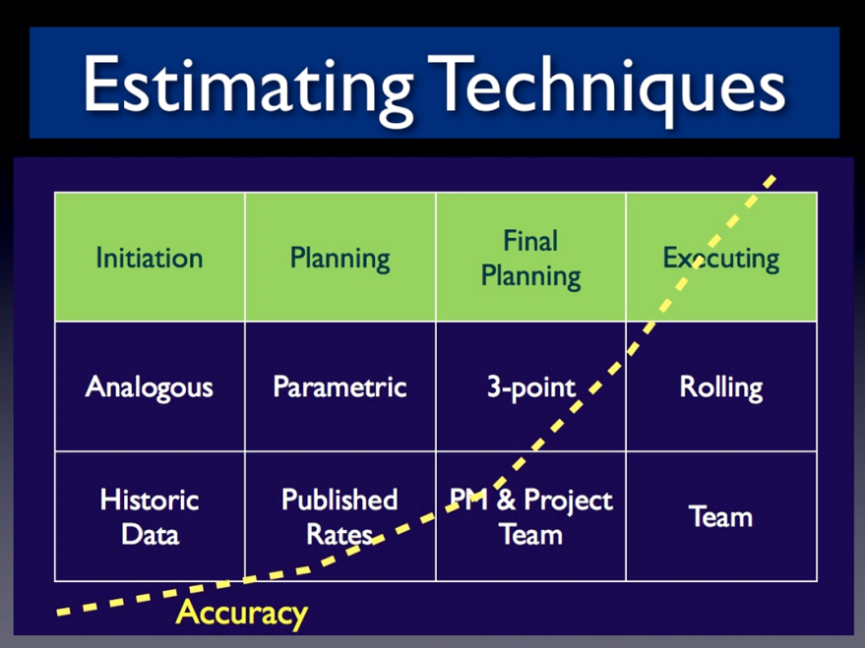
Cost Estimation Techniques
Basic tools and techniques for cost estimates:
Bottom-up estimates
PERT
Ex. The pessimistic cost estimate for an activity is $11,000, the optimistic estimate is $3,000 and the most likely estimate is $4,000. What should you use for the expected estimate?

Slide 10
Using Estimation Techniques
Top-Down Technique
Externally: used by organizations completing IT projects for other companies
Internally: can be used for similar projects
Problem
You are dealing with IT
Less Accurate Estimates

Slide 11
Using Estimation Techniques
Bottom-up Technique
Based on the WBS
Creates a detailed estimate of each work component
More Accurate
Can separate across phases
Would be better for controlling costs (Monday’s lecture)

Slide 12
Which technique is being used?
Based on the description below, what kind of estimate is being used?
It will take 20 hours of a programmer’s time to write this program. The average rate to hire a programmer is $50 per hour. Therefore, the cost of writing this program, assuming that everything else needed to write the program, such as a computer, is in place, is 20 x $50 = $1,000.

Slide 13
Typical Problems with IT Cost Estimates
Estimates are done too quickly
People lack estimating experience
Human beings are biased toward underestimation
Management desires accuracy
Contingency reserve is often used to reduce the risk from these problems

Slide 14
PM Network: Estimates are just that
“We are headed down the path of providing more precise estimates in an environment that is not as precise and where costs fluctuate greatly.”
Managing estimates through the lifecycle
Agile Estimating
Formulas for success

Slide 15
PM Network: Estimating Errors
“treat estimates as a living process and not a one time event.”
Approaches
Matching Skill Sets
Share Accountability

Slide 16
Review: Cost Estimate Technique (Parametric, Reserve Analysis, Bottom-up Estimate, Three-point estimate)
It was discovered that there are many unknowns about an activity and that it could cost a lot of more than estimated because it could take longer. So, some money is put aside to deal with the situation
There is a complicated activity for which there are many disagreements among the team about its cost estimate. So, an estimate was created by taking the average optimistic estimate, pessimistic estimate and realistic estimate.
The manager still had doubts about the estimate above so the complex activity was split up into smaller pieces. Estimate costs were placed on these pieces and then all were added up to reach the final figure/
For another activity, the number of work hours needed were multiplied by the hourly rate of a programmer

Slide 17
CP3: Determining the Budget
Cost budgeting involves allocating the project cost estimate to individual work items over time
The WBS is a required input to the cost budgeting process since it defines the work items
Reserve analysis must occur
Contingency reserves
Management reserves

Slide 18
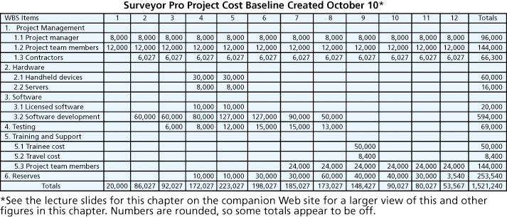
Figure 7-4. Surveyor Pro Project Cost Baseline

Slide 19
Chapter Summary
Project cost management is a traditionally weak area of IT projects, and project managers must work to improve their ability to deliver projects within approved budgets
Main processes include
Plan cost management
Estimate costs
Determine the budget
Control costs

Slide 20
CAPM – Things to know
Project budget is time-phased project cost (aggregating individual activity costs)
Contingency Reserves
Deal with uncertainties in schedule/cost
Deal with overruns of the project objectives
Analogous estimating takes less time but is also less accurate
Memorize the formulas for EV, CV, CPI, PV, SV, SPI

